Slide 1

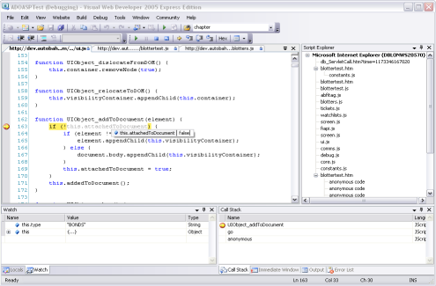
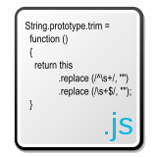
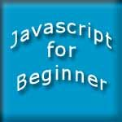

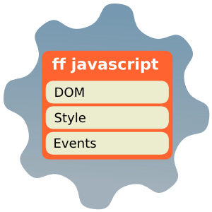

JavaScript Fundamentals
All in one place
HTML, CSS and JavaScript
Telerik School Academy
http://schoolacademy.telerik.com

Slide 2

Table of Contents
JavaScript Overview
JavaScript history
Usage in Web
JavaScript features
Variables, operators
Conditionals, loops
Functions
DOM API

Slide 3
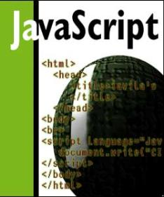


JavaScript
Dynamic Behavior in a Web Page

Slide 4
JavaScript
JavaScript is a scripting language developed by Netscape
Intended for a front-end, now is a full server language
Lightweight and fast
JavaScript can be:
Embedded in your HTML page
Interpreted by the Web browser
Simple and flexible
Powerful to manipulate the DOM

Slide 5
JavaScript Advantages
JavaScript allows interactivity such as:
Implementing form validation
React to user actions, e.g. handle keys
Changing an image on moving mouse over it
Sections of a page appearing and disappearing
Content loading and changing dynamically
Performing complex calculations
Custom HTML controls, e.g. scrollable table
Implementing AJAX functionality

Slide 6
What Can JavaScript Do?
Can handle events
Can read and write HTML elements and modify the DOM tree
Can validate form data
Can access / modify browser cookies
Can detect the user’s browser and OS
Can be used as object-oriented language
Can handle exceptions
Can perform asynchronous server calls (AJAX)

Slide 7
The First Script
Create a <script> HTML tag, and write your JavaScript inside
<html>
<body>
<script type="text/javascript">
var name = "Doncho Minkov";
var greeting = "Hello, " + name;
alert(greeting);
</script>
</body>
</html>

Slide 8
First JavaScript
Live Demo

Slide 9
Using JavaScript Code
The JavaScript code can be placed in:
<script> tag in the head
<script> tag in the body
External files, linked via <script> tag
Can be done in the head or in the body, depending on the case
JavaScript files have an extentions .js
Highly recommended
The .js files are being cached by the browser
<script src="scripts.js" type="text/javscript">
<!– code placed here will not be executed! -->
</script>

Slide 10
JavaScript – When is Executed?
JavaScript code is executed during the page loading or when the browser fires an event
All statements are executed at page loading
Some statements just define functions that can be called later
Function calls or code can be attached as "event handlers" via tag attributes or in code
Executed when the event is fired by the browser
<img src="logo.gif" onclick="alert('clicked!')" />

Slide 11
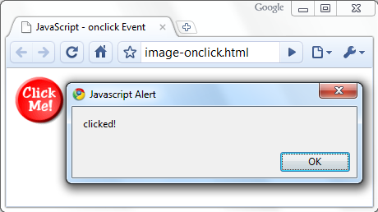
Calling a JavaScript Function from Event Handler – Example
<html>
<head>
<script>
function printMessage (message) {
alert(message);
}
</script>
</head>
<body>
<img src="logo.gif"
onclick="printMessage('clicked!')" />
</body>
</html>

Slide 12
Using External Script Files
Using external script files:
External JavaScript file:
<html>
<head>
<script src="external.js">
</script>
</head>
<body>
<button onclick="printMessage('Hello from file')"
value="Call js function from external file" />
</body>
</html>
function printMessage(message) {
alert(message)
}

Slide 13
Using External Script Files
Using external script files:
External JavaScript file:
<html>
<head>
<script src="external.js">
</script>
</head>
<body>
<button onclick="printMessage('Hello from file')"
value="Call js function from external file" />
</body>
</html>
The <script> tag is always empty.
function printMessage(message) {
alert(message)
}

Slide 14
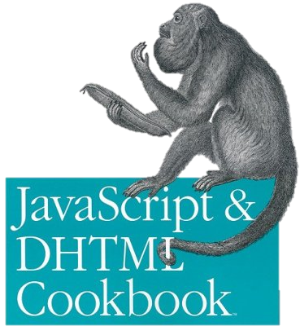
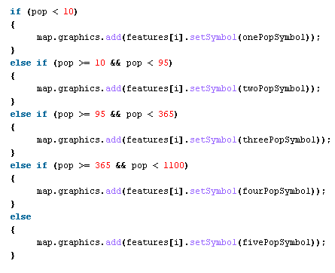

The JavaScript Syntax

Slide 15
JavaScript Syntax
The JavaScript syntax is similar to C# and Java
Operators (+, *, =, !=, &&, ++, …)
Variables (typeless)
Conditional statements (if, else)
Loops (for, while)
Arrays (myArray[]) and associative arrays (myHash['abc'])
Functions (can return value)
Function expressions (like the C# delegates)

Slide 16
Data Types
JavaScript data types:
Numbers (integer, floating-point)
Boolean (true / false)
String type – string of characters
Arrays contain items of mixed types:
Associative arrays (hash tables):
var message = 'You can use both single or double quotes for strings, yet use single quotes';
var mixedArray = [1, 5.3, 'aaa'];
var location = {
street: '22 Al. Malinov str.',
city: 'Sofia',
country: 'Bulgaria'
};

Slide 17
Everything is Object
Every variable is an object
Strings have functions:
var name = 'Doncho Minkov';
console.log(name[7]); // shows 'M'
console.log(name.substring(7,13)//shows 'Minkov'
console.log(name.substr(7, 6)); //shows 'Minkov'
Arrays have functions:
var numbers = [1, 3, 4];
console.log (arr.length); // shows 3
arr.push(7); // appends 7 to end of array
arr.unshinf(-5); //adds -5 to the head of the array
console.log (arr[3]); // shows 4

Slide 18
String Operations
The + operator joins strings
What is '9' + 9?
Converting string to number:
or
string1 = 'fat ';
string2 = 'cats';
console.log(string1 + string2); // fat cats
console.log('9' + 9); // 99
console.log(parseInt('9') + 9); // 18
console.log('9' * 1 + 9); // 18

Slide 19
Arrays Operations and Properties
Declaring new empty array:
Declaring an array holding few elements:
Appending an element / getting the last element:
Reading the number of elements (array length):
Finding element's index in the array:
var arr = []
var arr = [1, 2, 3, 4, 5];
arr.push(3);
var element = arr.pop();
arr.length;
arr.indexOf(1);

Slide 20
Sum of Numbers – Example
<html>
<head>
<title>JavaScript Demo</title>
<script type="text/javascript">
function calcSum() {
value1 =
parseInt(document.mainForm.textBox1.value);
value2 =
parseInt(document.mainForm.textBox2.value);
sum = value1 + value2;
document.mainForm.textBoxSum.value = sum;
}
</script>
</head>

Slide 21
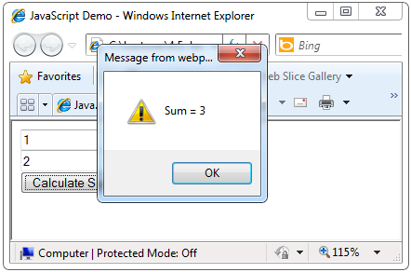
Sum of Numbers – Example (2)
<body>
<form name="mainForm">
<input type="text" name="textBox1" /> <br/>
<input type="text" name="textBox2" /> <br/>
<input type="button" value="Process"
onclick="javascript: calcSum()" />
<input type="text" name="textBoxSum"
readonly="readonly"/>
</form>
</body>
</html>

Slide 22
Sum of Numbers
Live Demo

Slide 23
Conditional Statement (if)
unitPrice = 1.30;
if (quantity > 100) {
unitPrice = 1.20;
}
Symbol
Meaning
>
Greater than
<
Less than
>=
Greater than or equal to
<=
Less than or equal to
==
Equal
!=
Not equal

Slide 24

Conditional Statement (if) (2)
The condition may be of Boolean or any other type:
var a = 0;
var b = true;
if (typeof(a)=='undefined' || typeof(b)=='undefined') {
document.write('Variable a or b is undefined.');
}
else if (!a && b) {
document.write('a==0; b==true;");
} else {
document.write("a==" + a + "; b==" + b + ";");
}

Slide 25
Conditional Statements
Live Demo

Slide 26
Switch Statement
The switch statement works like in C#:
switch (variable) {
case 1:
// do something
break;
case 'a':
// do something else
break;
case 3.14:
// another code
break;
default:
// something completely different
}

Slide 27
Switch-case
Live Demo

Slide 28
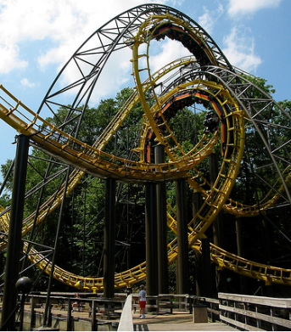

Loops
Like in C#
for loop
while loop
do … while loop
var counter;
for (counter=0; counter<4; counter++) {
alert(counter);
}
while (counter < 5) {
alert(++counter);
}

Slide 29
Loops
Live Demo

Slide 30
Functions
Code structure – splitting code into parts
Data comes in, processed, result returned
Parameters come in here.
function average(a, b, c)
{
var total;
total = a+b+c;
return total/3;
}
Declaring variables is optional. Type is never declared.
Value returned here.

Slide 31
Function Arguments and Return Value
Functions are not required to return a value
When calling function it is not obligatory to specify all of its arguments
The function has access to all the arguments passed via arguments object
function sum() {
var sum = 0;
for (var i = 0; i < arguments.length; i ++)
sum += parseInt(arguments[i]);
return sum;
}
alert(sum(1, 2, 4));

Slide 32
Functions
Live Demo

Slide 33
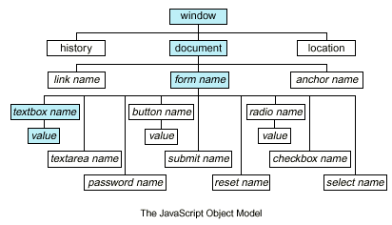
Document Object Model (DOM)

Slide 34
Document Object Model (DOM)
Every HTML element is accessible via the JavaScript DOM API
Most DOM objects can be manipulated by the programmer
The event model lets a document to react when the user does something on the page
Advantages
Create interactive pages
Updates the objects of a page without reloading it

Slide 35
Accessing Elements
Access elements via their ID attribute
Via the name attribute
Via tag name
Returns array of descendant <img> elements of the element "el"
var elem = document.getElementById("some-id")
var arr = document.getElementsByName("some-name")
var imgTags = el.getElementsByTagName("img")

Slide 36
DOM Manipulation
Once we access an element, we can read and write its attributes
function change(state) {
var lampImg = document.getElementById("lamp");
lampImg.src = "lamp_" + state + ".png";
var statusDiv =
document.getElementById("statusDiv");
statusDiv.innerHTML = "The lamp is " + state";
}
…
<img src="test_on.gif" onmouseover="change('off')"
onmouseout="change('on')" />

Slide 37
DOM Manipulations
Live Demo

Slide 38
Common Element Properties
Most of the properties are derived from the HTML attributes of the tag
E.g. id, name, href, alt, title, src, etc…
style property – allows modifying the CSS styles of the element
Corresponds to the inline style of the element
Not the properties derived from embedded or external CSS rules
Example: style.width, style.marginTop, style.backgroundImage

Slide 39
Changing the Style of an Element
Live Demo

Slide 40
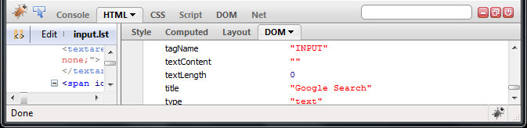
Common Element Properties (2)
className – the class attribute of the tag
innerHTML – holds all the entire HTML code inside the element
Read-only properties with information for the current element and its state
tagName, offsetWidth, offsetHeight, scrollHeight, scrollTop, nodeType, etc…

Slide 41
Accessing Elements through the DOM Tree Structure
We can access elements in the DOM through some tree manipulation properties:
element.childNodes
element.parentNode
element.nextSibling
element.previousSibling
element.firstChild
element.lastChild

Slide 42
Accessing Elements through the DOM Tree – Example
var el = document.getElementById('div-tag');
alert (el.childNodes[0].value);
alert (el.childNodes[1].
getElementsByTagName('span').id);
…
<div id="div-tag">
<input type="text" value="test text" />
<div>
<span id="test">test span</span>
</div>
</div>
Warning: may not return what you expected due to Browser differences

Slide 43
Traversing the DOM
Live Demo

Slide 44
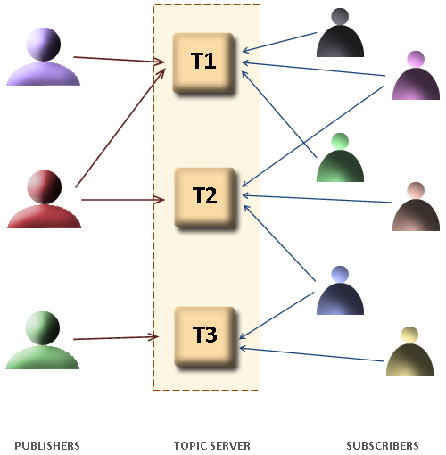
The HTML DOM Event Model

Slide 45
The HTML DOM Event Model
JavaScript can register event handlers
Events are fired by the Browser and are sent to the specified JavaScript event handler function
Can be set with HTML attributes:
Can be accessed through the DOM:
<img src="test.gif" onclick="imageClicked()" />
var img = document.getElementById("myImage");
img.addEventListener("click', imageClicked);

Slide 46
On Click Event Listener
Live Demo

Slide 47
The HTML DOM Event Model (2)
All event handlers receive one parameter
It brings information about the event
Contains the type of the event (mouse click, key press, etc.)
Data about the location where the event has been fired (e.g. mouse coordinates)
Holds a reference to the event sender
E.g. the button that was clicked

Slide 48


The HTML DOM Event Model (3)
Holds information about the state of [Alt], [Ctrl] and [Shift] keys
Some browsers do not send this object, but place it in the document.event
Some of the names of the event’s object properties are browser-specific

Slide 49
Common DOM Events
Mouse events:
onclick, onmousedown, onmouseup
onmouseover, onmouseout, onmousemove
Key events:
onkeypress, onkeydown, onkeyup
Only for input fields
Interface events:
onblur, onfocus
onscroll

Slide 50
Common DOM Events (2)
Form events
onchange – for input fields
onsubmit
Allows you to cancel a form submission
Useful for form validation
Miscellaneous events
onload, onunload
Allowed only for the <body> element
Fires when all content on the page was loaded / unloaded

Slide 51
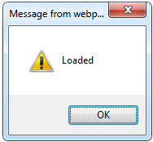
onload Event – Example
onload event
<html>
<head>
<script type="text/javascript">
function greet() {
alert('Loaded!');
}
</script>
</head>
<body onload="greet()" >
</body>
</html>

Slide 52
On Loaded Event Listener
Live Demo

Slide 53
JavaScript Fundamentals
http://academy.telerik.com

